Slide 1

Artificial Intelligence Tools & principles Pierre-Alexandre Balland
Utrecht University
AI Toulouse Institute
Notes:
What do you remember from last week? What amazed/surprised you the most?

Slide 2
We don’t have intelligent machines - we have fast and accurate prediction machines
Notes:
Organize private trainsings, products, inve strat

Slide 3






Champions of the first AI wave

Slide 4
The goal for this lecture is to introduce how to solve real-world problems with AI
Notes:
Organize private trainsings, products, inve strat

Slide 5
Decision Makers
What is the business problem?
Business/Data Interface
Re-frame as a data science problem
Solve a data science problem with specific AI techniques
Data Science
Team

Slide 6
To solve real-world problem with AI you don’t need the most advanced AI tools – you need creative problem-solving skills
Notes:
Organize private trainsings, products, inve strat

Slide 7
No AI without data
A lot of discussion around AI algorithms but data is what makes AI truly possible
AI problem-solving requires to: - know the kind of data AI needs - mentally map the problem into a data problem - know how to access or collect data - perform data transformation (i.e matrix format, rescaling) - data cleansing (missing, extreme, wrong…) - inspection & validation - simple data science models
Notes:
15 years older algorithms

Slide 8
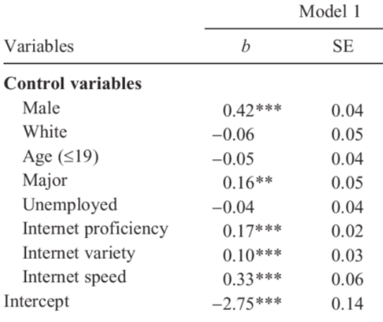
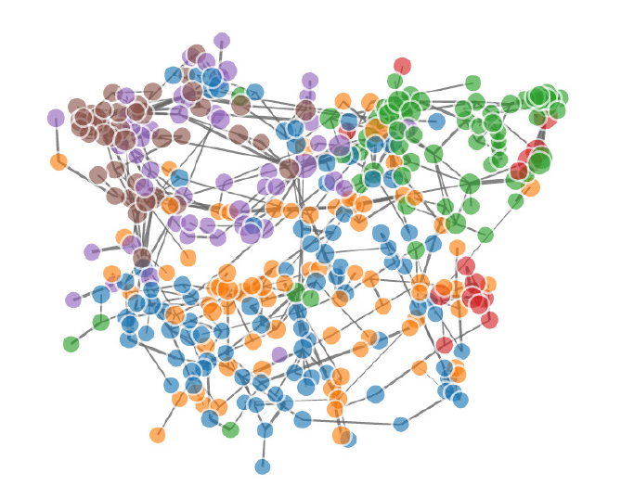
Two types of data
Individual characteristics Interconnection data
Notes:
15 years older algorithms

Slide 9
Physical world
Socio-economic world
Most of the world
is very poor
Most humans have a similar height
Gaussian
(normal)
distribution
% of population
Very few take it all
Extremes (3m tall don’t exist)
Fat tails
Height
Wealth
Notes:
Show the math reflection that the more we move to a complex world, the more unequal
We have been trained to think that the world works this way, changes everything

Slide 10
Edge list
Directed graph (digraph)
Vertex | Vertex
1 | 2
1 | 3
2 | 3
2 | 4
1
2
3
4
Adjacency matrix
Vertex | 1 | 2 | 3 | 4
1 | - | 1 | 1 | 0
2 | 0 | - | 1 | 1
3 | 0 | 0 | - | 0
4 | 0 | 0 | 0 | -

Slide 11
AI algorithms have considerably evolved since the 1950s
Notes:
Organize private trainsings, products, inve strat

Slide 12
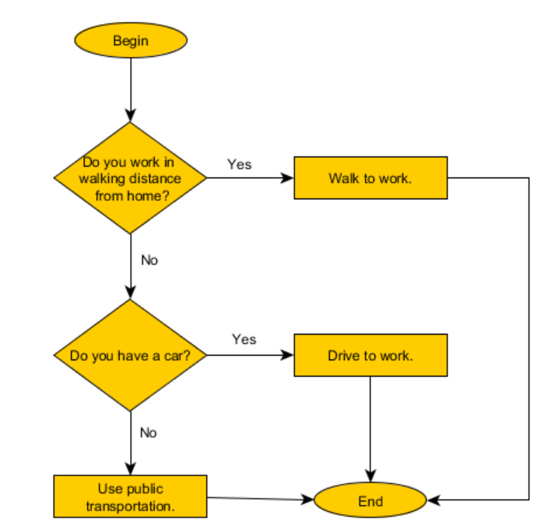
Simple algorithms
Humans have solved algorithms before computers
An algorithm is a sequence of operations (series of steps)
Complex problems require huge amount of numeric computation (time) – non-human computers are perfect for this task
AI algorithms deal with problems that usually require human intelligence

Slide 13
AI expert systems
Improvement compared to hard-coded algorithms
Introduce flexibility in the rule (more adapted to a complex environment)
Knowledge base and inference engine are constructed from human experts
Still exist today for some very codified problems (grammar checkers)
Also relevant today problems that have ethical and legal considerations (require transparent rules)
Notes:
Expert systems still exists

Slide 14
Machine learning
Solutions capable of learning directly from data
ML is particularly adapted to problems that humans don’t know how to codify in pre-defined steps
ML creates a mathematical representation of the world that it guesses by seeing (a lot of) data
ML can be applied after careful data analysis (to provide correct input)
Learning = associating inputs and outputs – not understanding (we talk about training)
Notes:
Expert systems still exists

Slide 15
What makes ML special
Traditional algorithm: you know the inputs (10 and 2), you know the function (*) but you don’t know the results (20)
ML algorithm: you know the inputs (10 and 2), you know the results (20), but you don’t know the function (*)
Replace theory with data (deduction VS induction) & hypothesis testing in the scientific method
You need a lot of data!
Notes:
Expert systems still exists

Slide 16
The limits of ML
ML can only solve single and specific problems (representation issue)
Overfitting = like students studying too much passed exams. Internal functions memorize and don’t learn from the data
Bias can be magnified
Notes:
Expert systems still exists

Slide 17
How do ML learn?
Supervised learning: humans train the ML with good labeled data examples and the algorithm derives rules from these specific examples
→ regression & classification problems
Unsupervised learning: no labeled data - the algorithm guesses that some objects or events cluster together (belong to the same class) without being explicitly told (find similar patterns)
Reinforcement learning: lack labels too, but humans provide positive/negative feedback
Notes:
Expert systems still exists

Slide 18
Deep learning
DL is the latest major advance in AI algorithms (2012) that sparked a renewed major interest in AI
If you don’t have much data: expert systems, a lot: ML, a gigantic amount: DL
DL is neural networks on steroids
Major breakthroughs: backpropagation + vanishing gradients (signal fades)
Notes:
Expert systems still exists

Slide 19
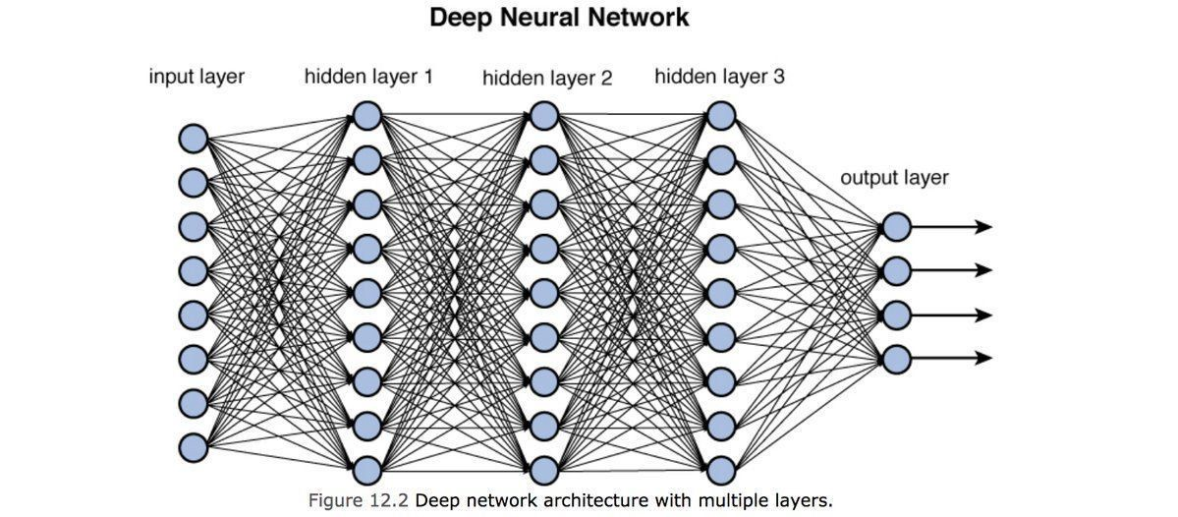
Deep learning
Notes:
Expert systems still exists

Slide 20
Major limitations with DL
It is a black box – humans also don’t understand what happens within the neural network
Requires a huge number of examples/data (impractical in many ways)
DL can not transfer knowledge to higher level (can’t create hierarchies of knowledge)

Slide 21
AI
Machine Learning
Deep learning
Notes:
Organize private trainsings, products, inve strat

Slide 22
Building your own recommender system with simple unsupervised ML
Notes:
Organize private trainsings, products, inve strat

Slide 23
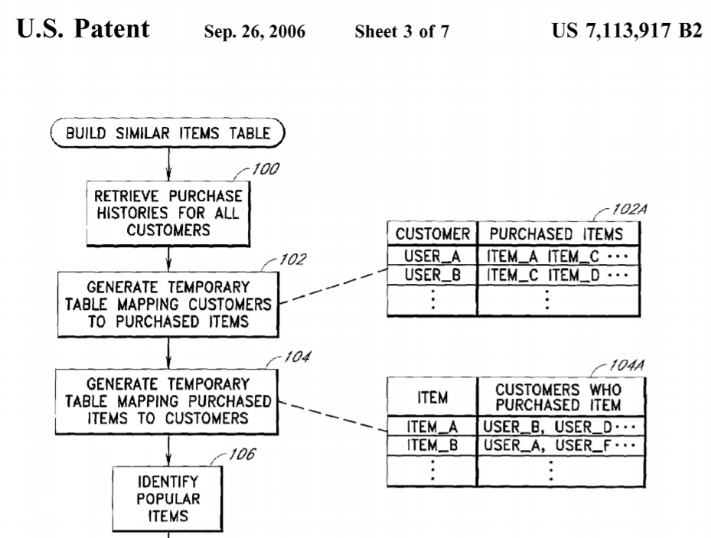

What AI can predict
Modern AI techniques are good at predicting the evolution of simple network structures
Notes:
That you can predict because you see the connections – if you don’t see them forget about it

Slide 24
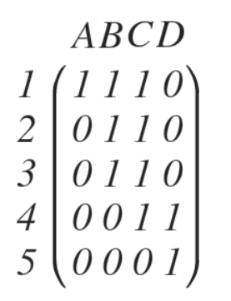
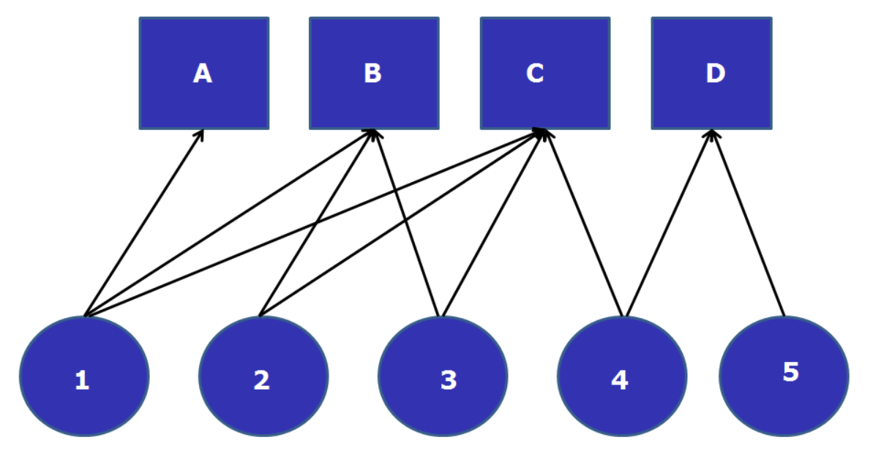
1. Seeing the data matrix

Slide 25


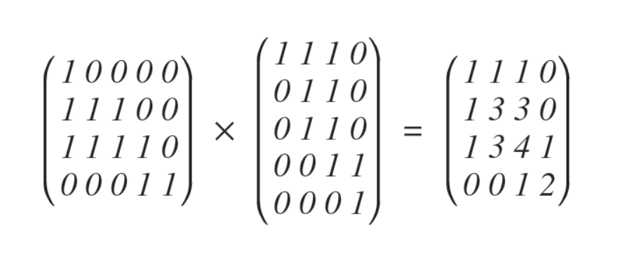
2. Multiply t(M) by M
1*1+1*1+1*1+0*1+0*0 = 3

Slide 26
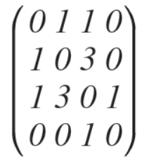
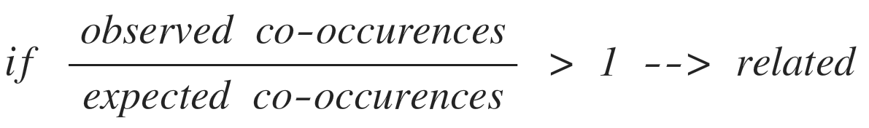
3. Normalization

Slide 27
4. Network graph

Slide 28
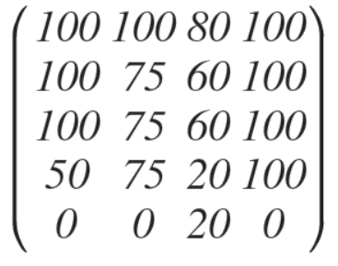
5. Recommendation list

Slide 29

EU smart specialization ($120 billion )
Complexity
High Risks
High Benefits
Low Risks
High Benefits
High Risks
Low Benefits
Low Risks
Low Benefits
Relatedness
Balland, P.A., Boschma, R., Crespo, J. and Rigby, D. (2019) Smart Specialization policy in the EU: Relatedness, Knowledge Complexity and Regional Diversification, Regional Studies

